Slide 1
TEAM 10
Simulation and Design of mini production Line

Slide 2
Team members
Mostafa El-feel
Youssef Khaled
Mohamed Sherif Shabaan
Mohamed Sherif Farid
Youssef Ashraf

Slide 3
Content
1. Introduction
2. Control and stateflow
General Idea for our project
How did we control our project
3. Subsystems
4. Actuator sizing
Description of each subsystem
Actuator calculations and selection
5. Full system
6. Conclusion
Implementation of all systems
Considerations and manufacturing

Slide 4
Introduction

Slide 5
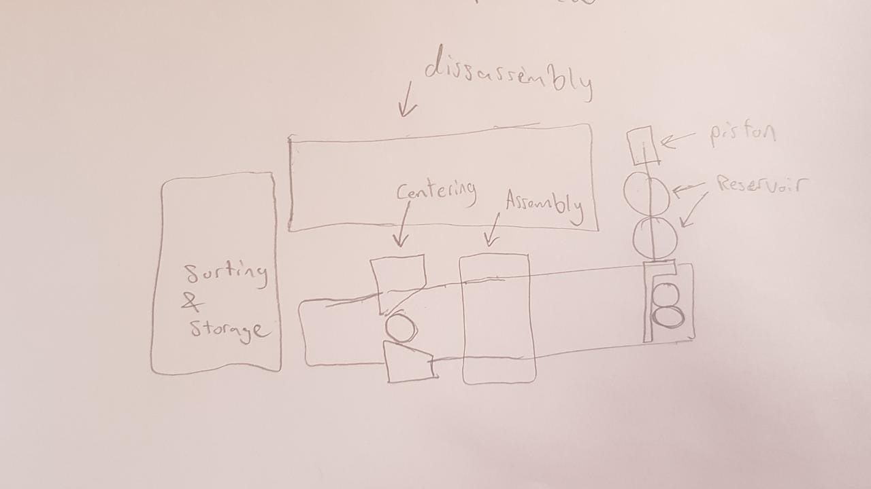
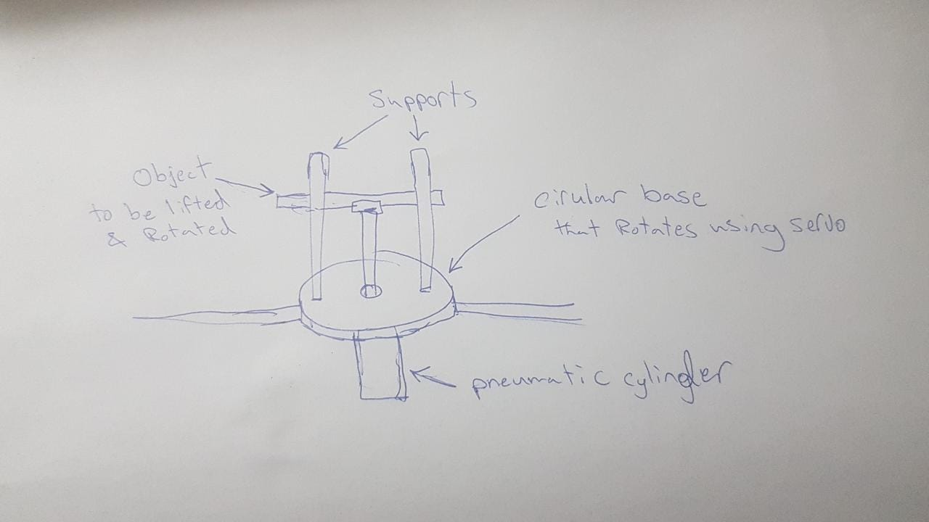
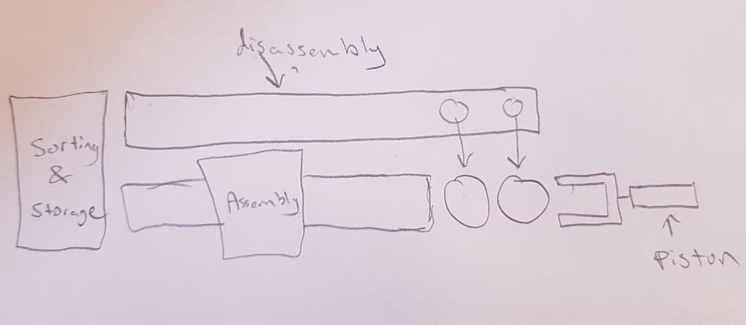
Introduction
Our perspective for the project
Simple
Different
Pneumatic and motor actuation hybrid

Slide 6
Control and state-flow

Slide 7
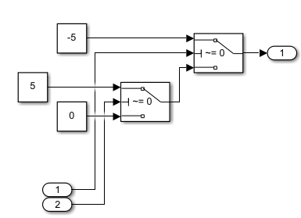
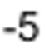
Control Strategy
We synchronized the control process for the entire project
Inputs are Torque/force and output position
2 levels of switches
Requires a 0/1 signal
00 -> stop
10 -> positive
01 -> negative

Slide 8
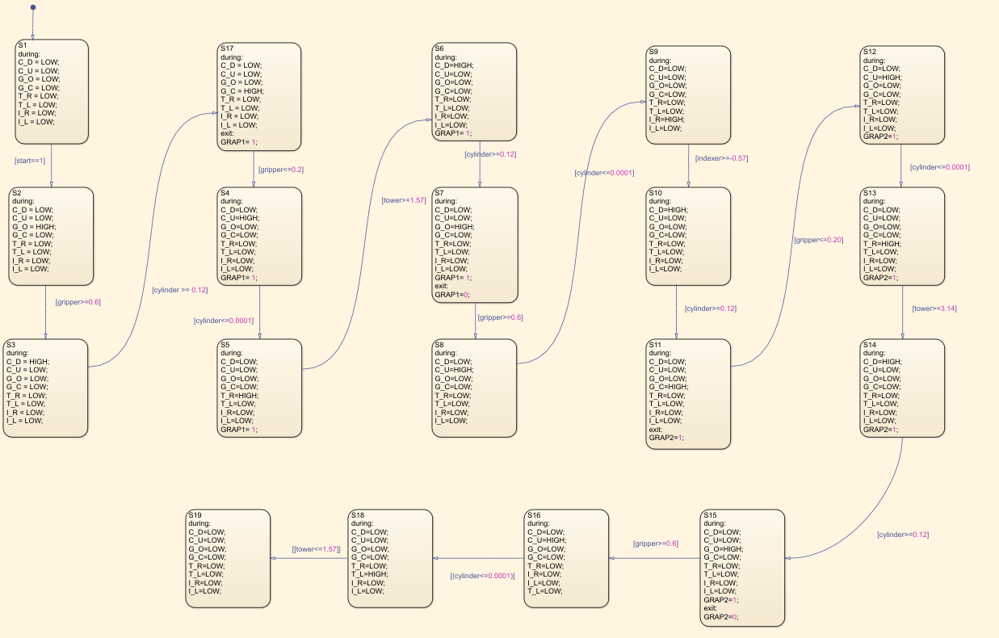
Stateflow
Our state-flow is a simple sequential states. Which takes objects position and outputs 1s and 0s to the controllers
.

Slide 9
Subsystems

Slide 10
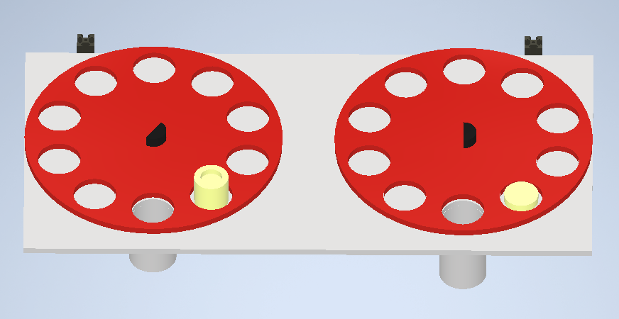
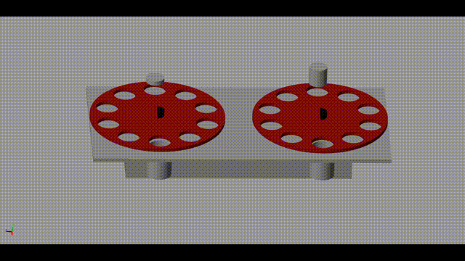
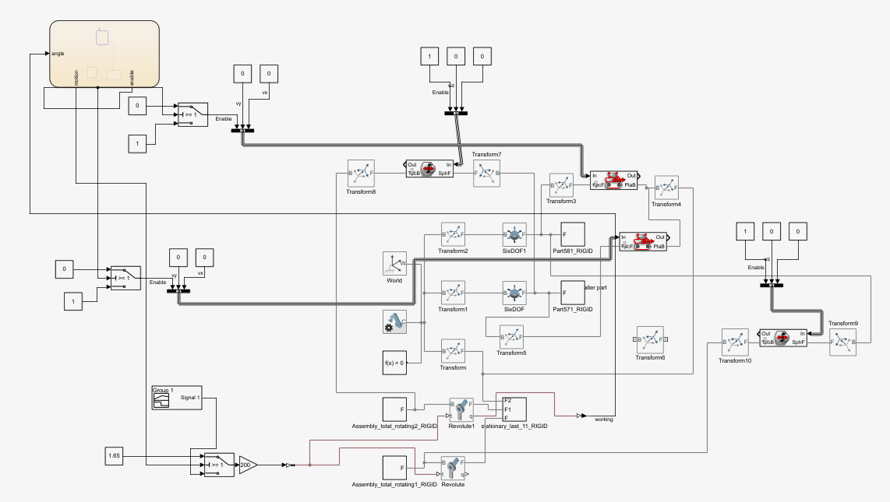
Feeding

Slide 11
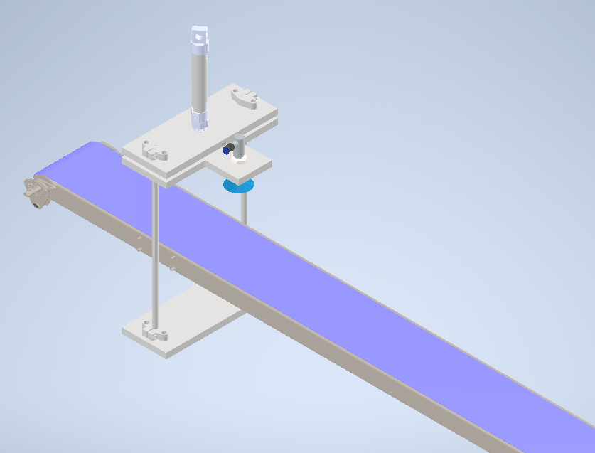
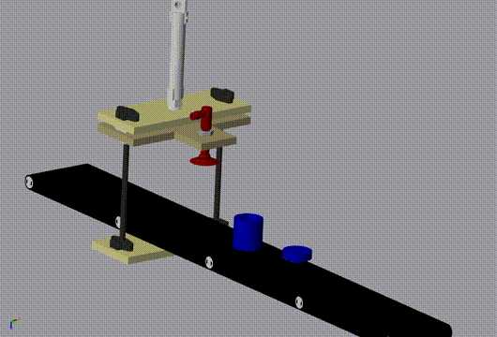
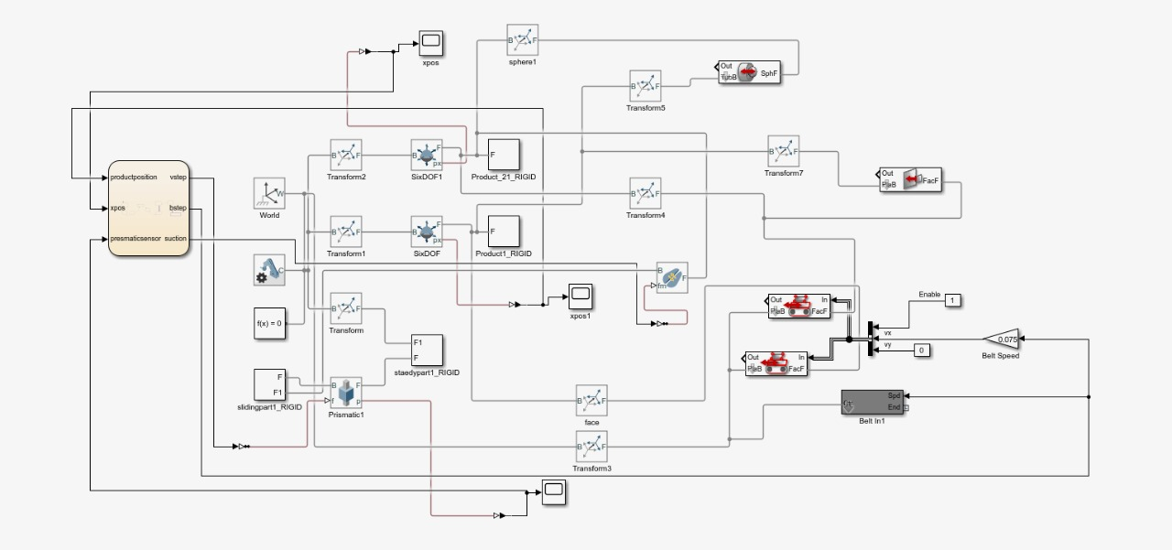
Assembly

Slide 12
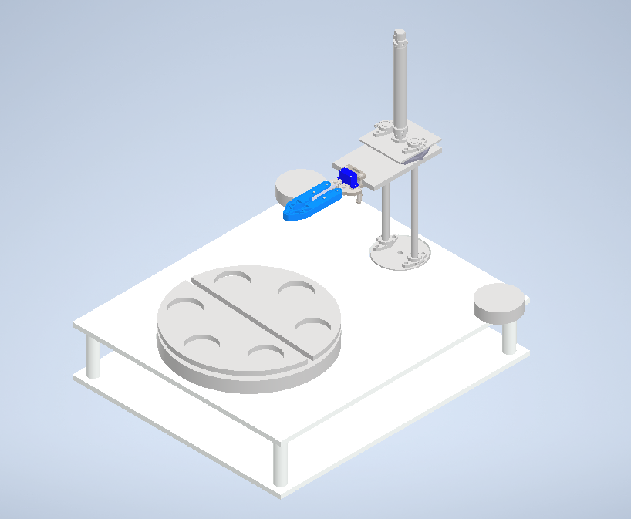
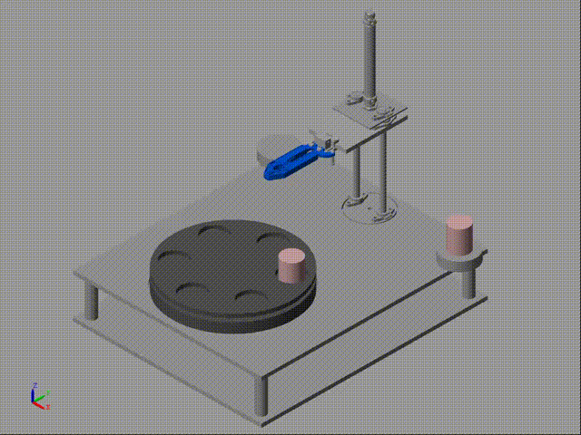
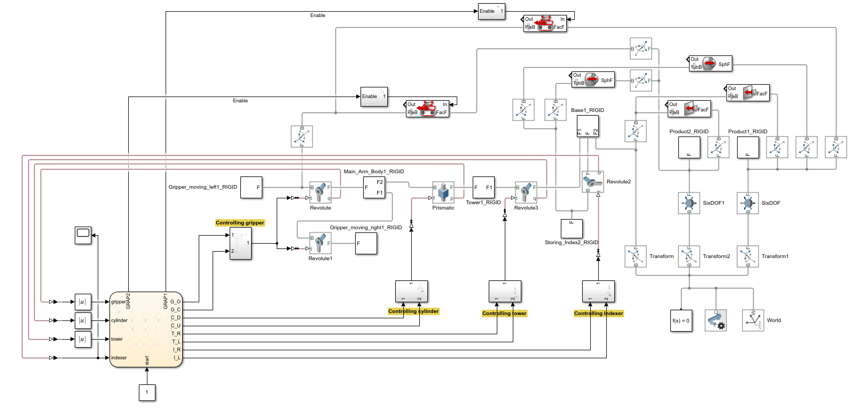
Sorting & Storage

Slide 13
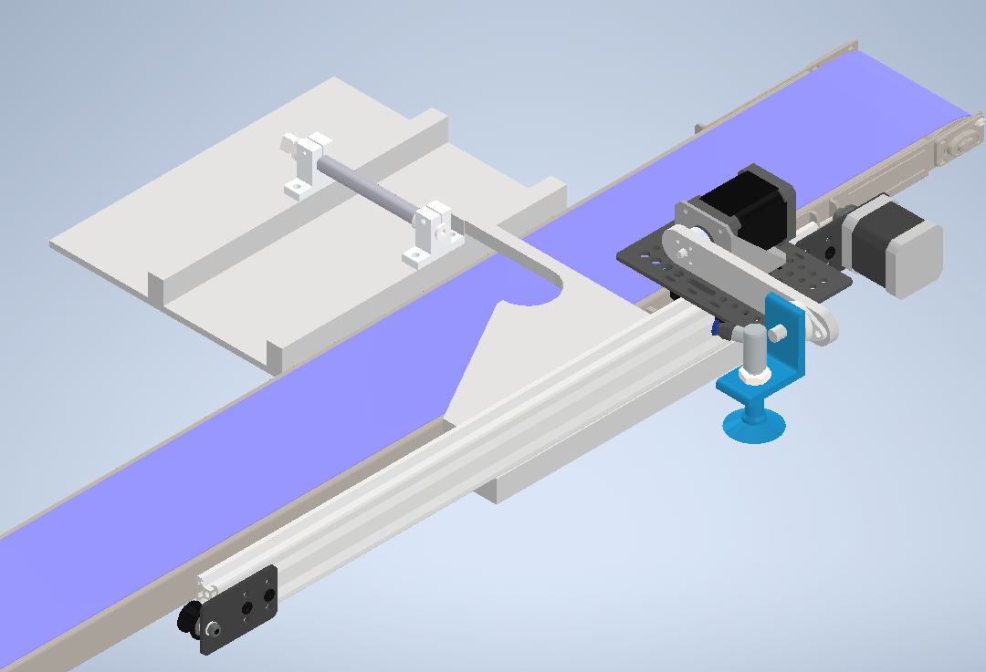
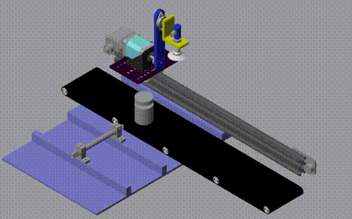
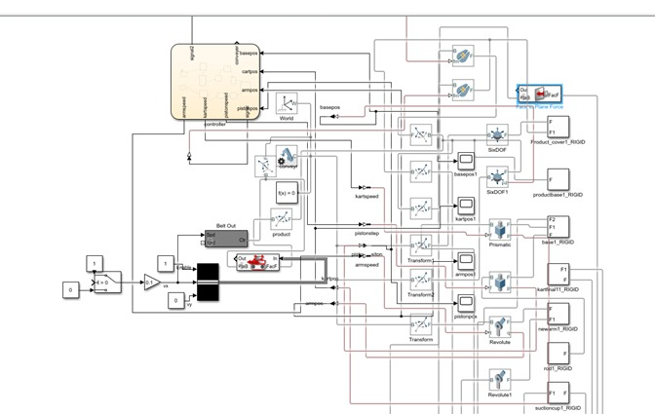
Disassembly

Slide 14
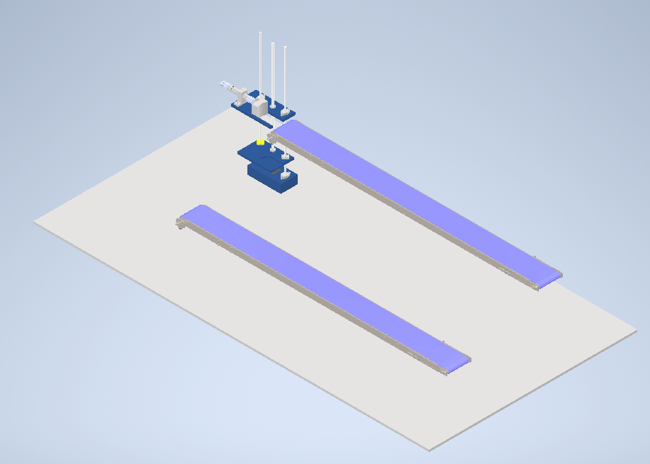
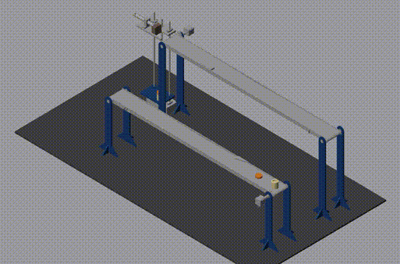
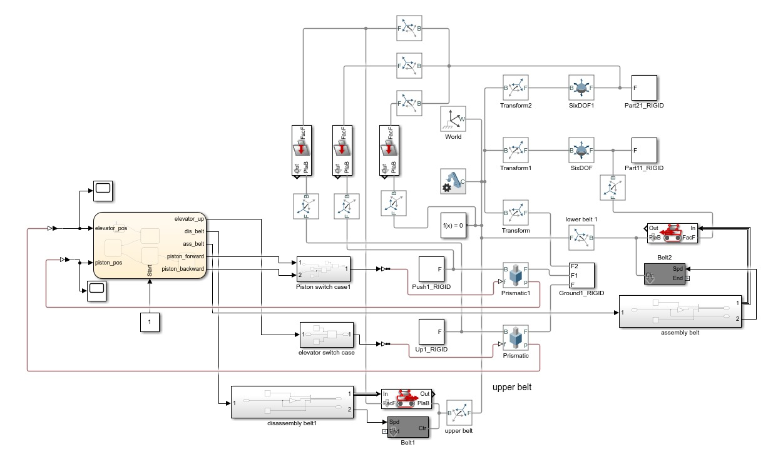
Handling

Slide 15
Actuator sizing

Slide 16
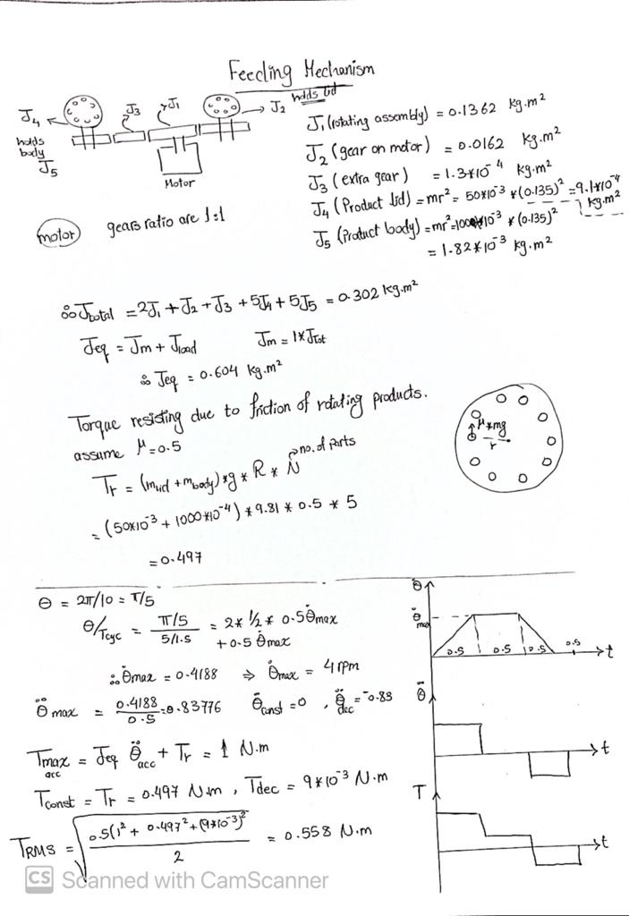
Actuator Sizing
Feeding

Slide 17
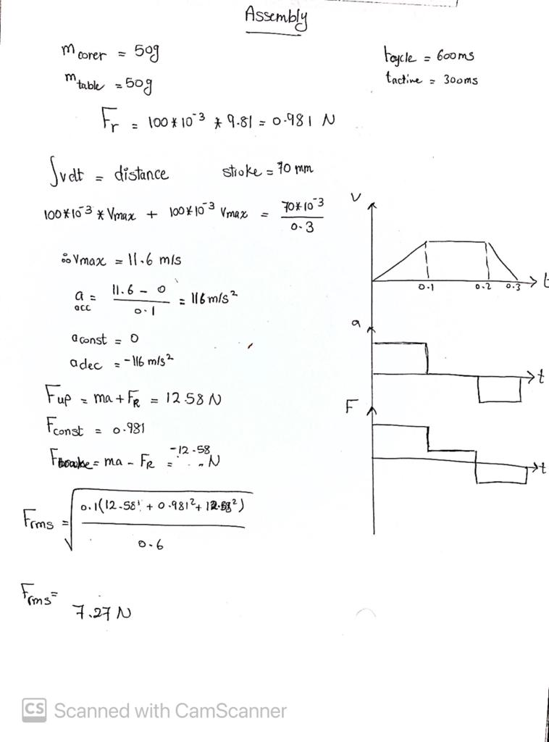
Actuator Sizing
Assembly

Slide 18
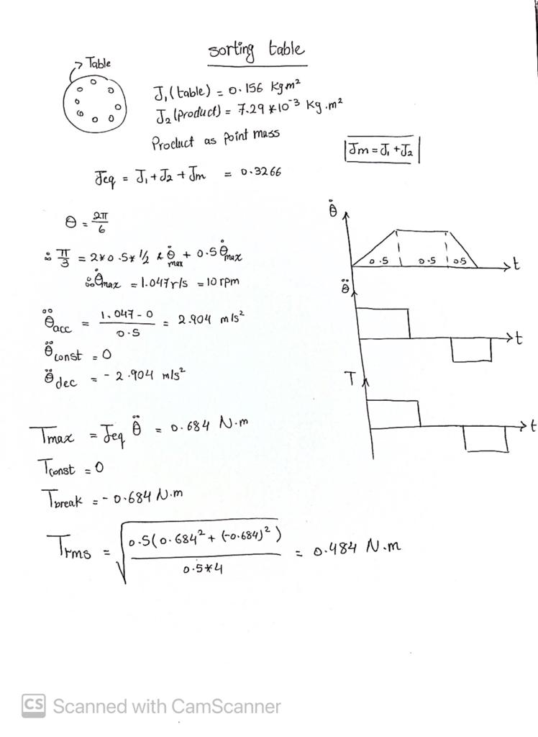
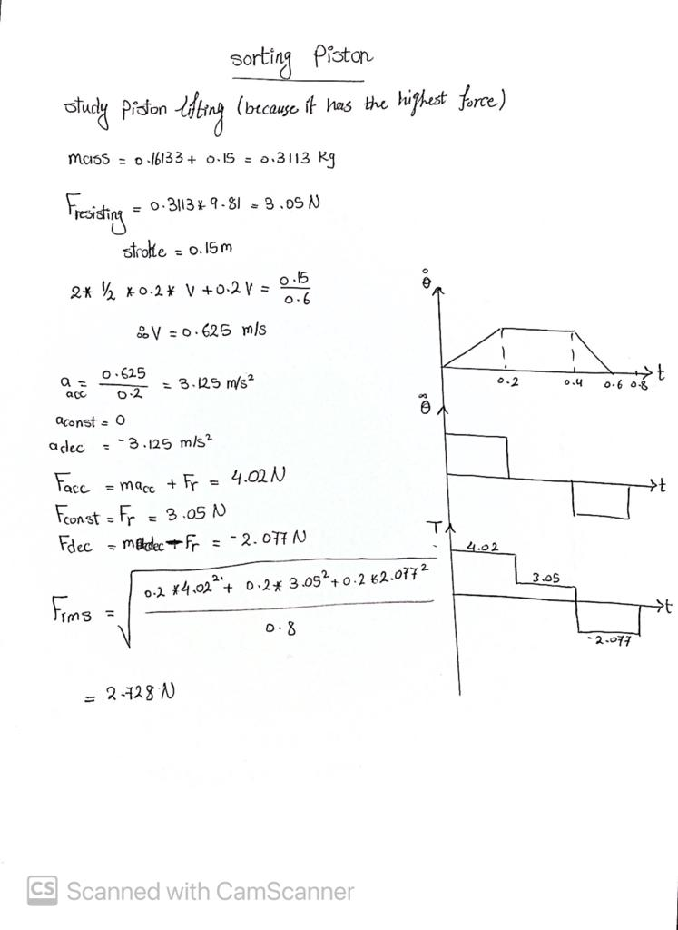
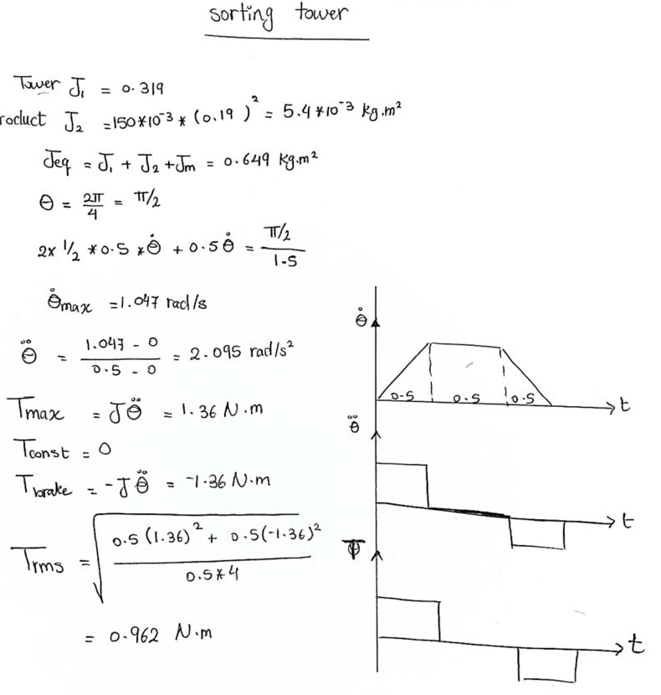
Actuator Sizing
Sorting and storing

Slide 19
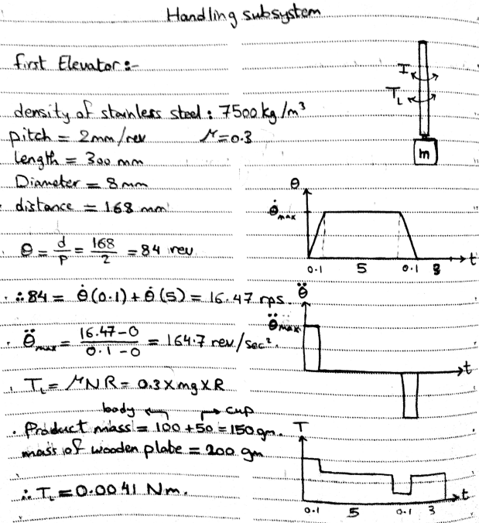
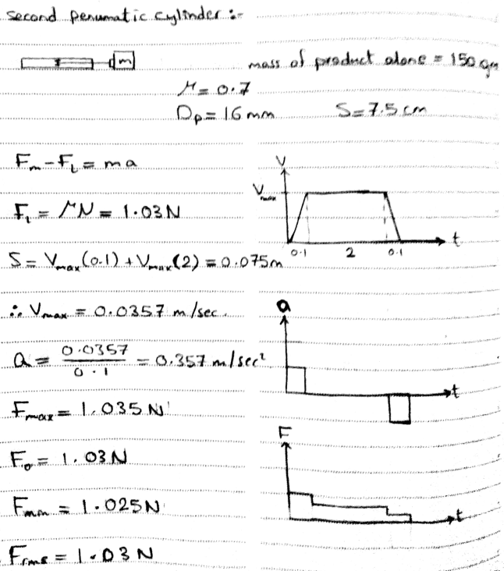
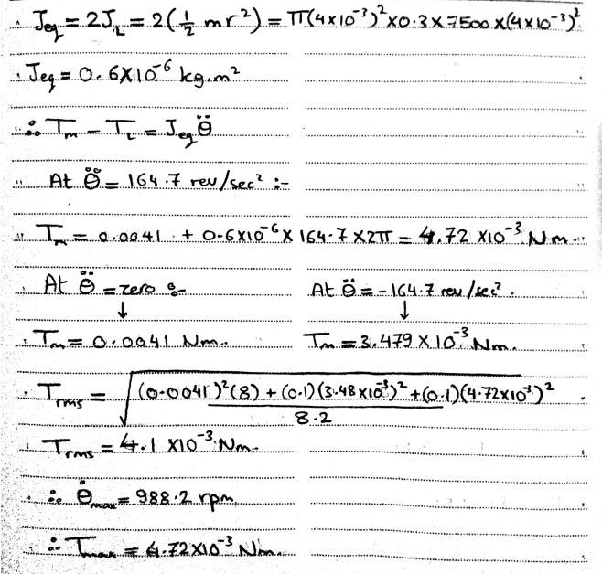
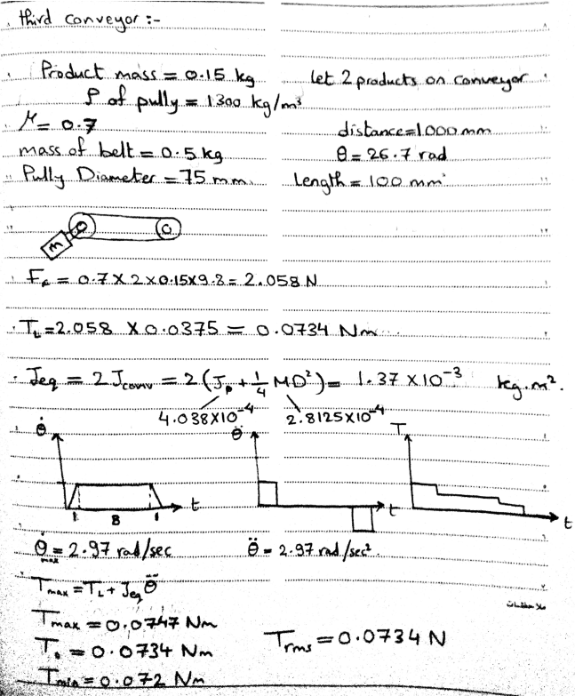
Actuator Sizing
Handling

Slide 20
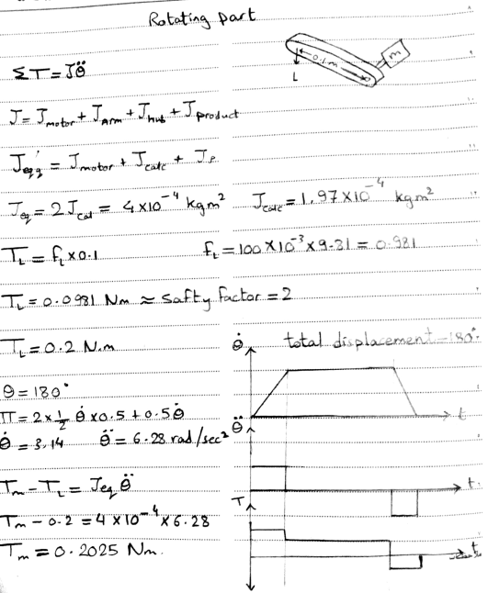
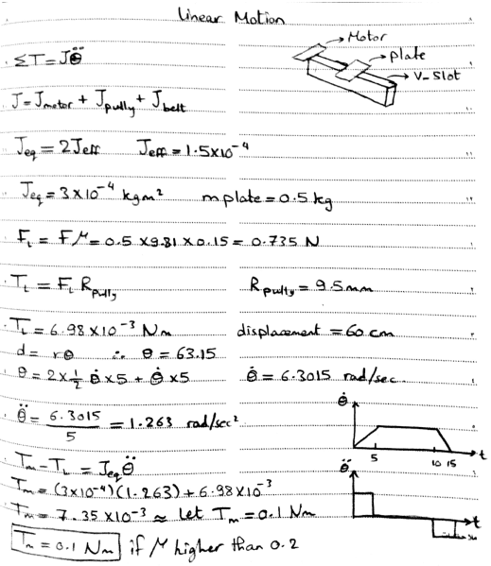
Actuator Sizing
disassembly

Slide 21
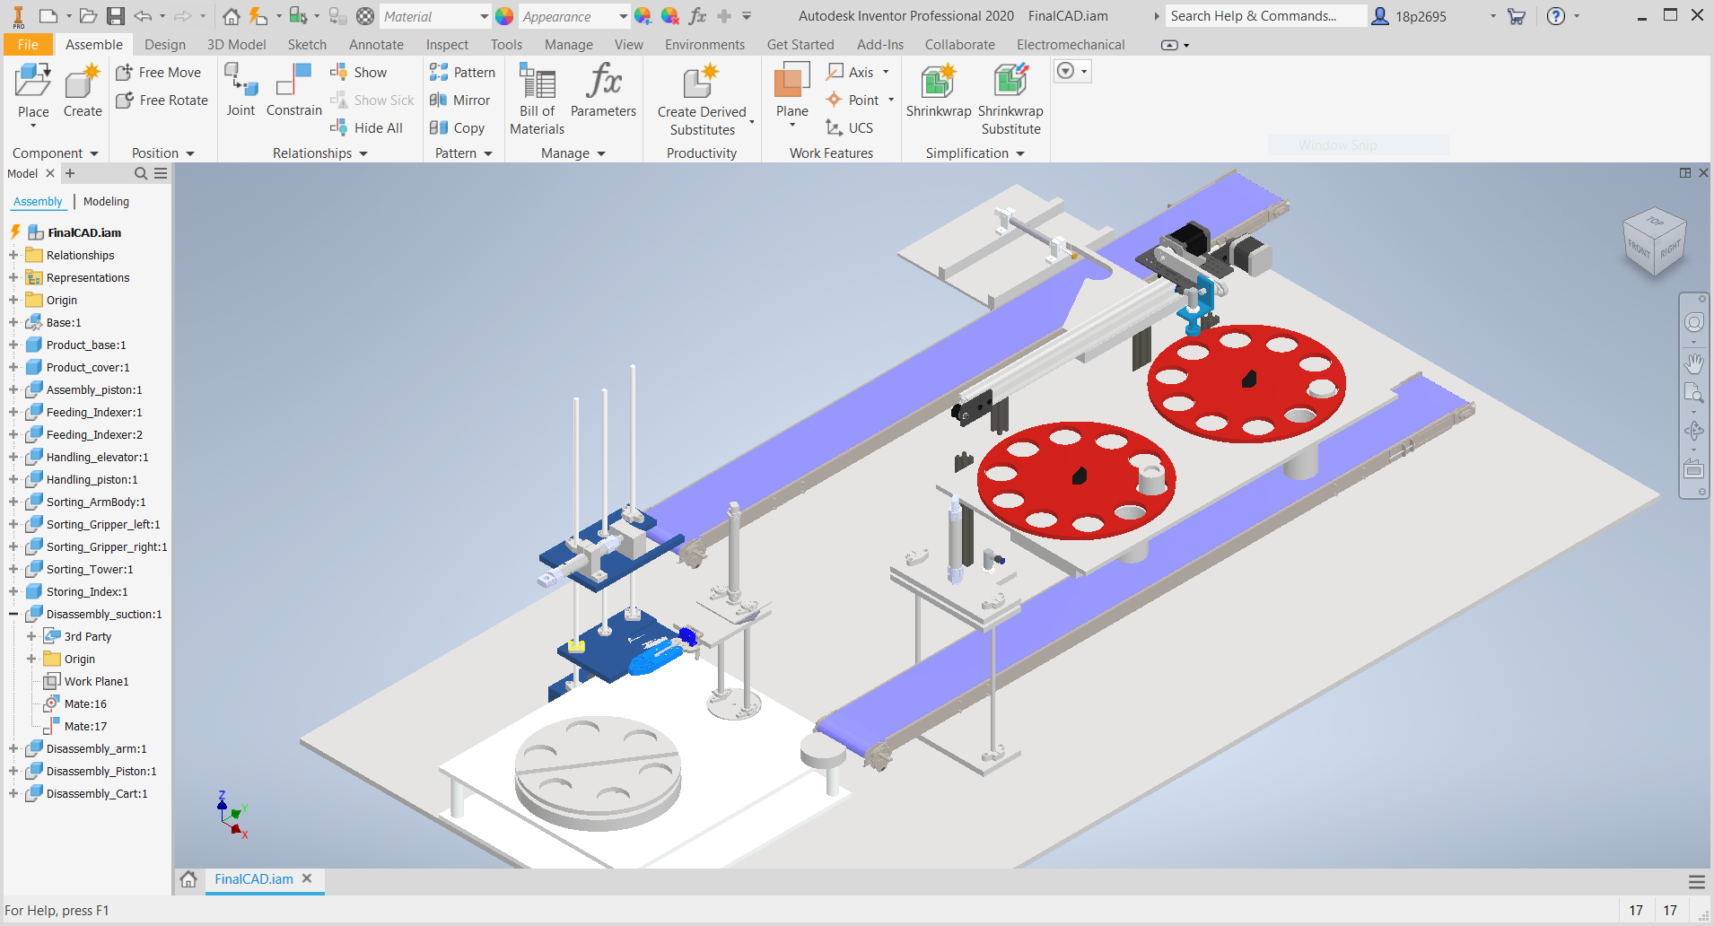
Full System

Slide 22
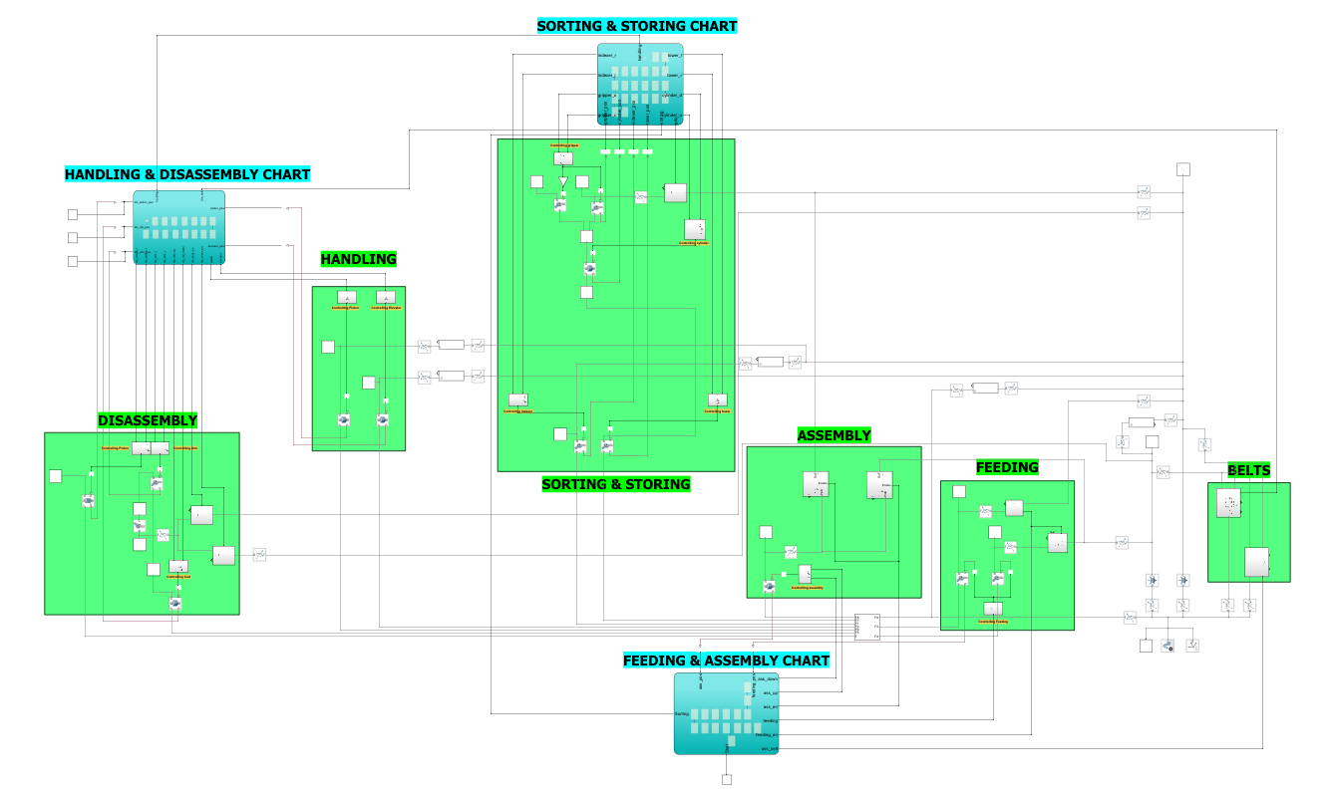
Full System

Slide 23
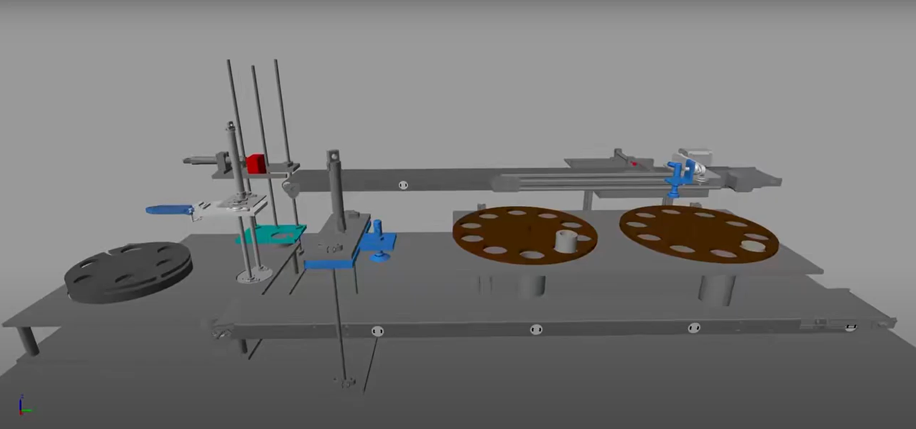
Full System
Full system simulation video:
https://youtu.be/nppwuOk6dds

Slide 24
Conclusion

Slide 25
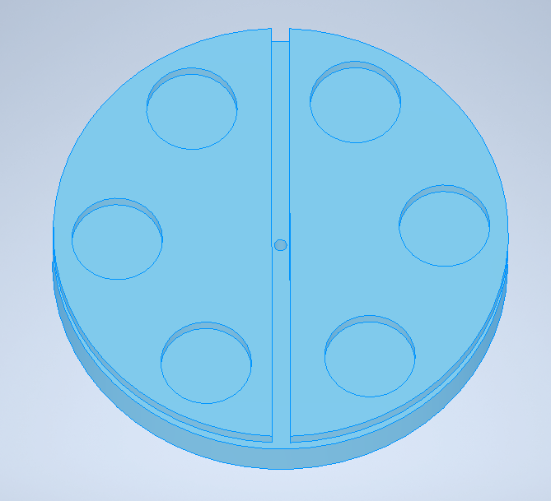
Conclusion
ARTELON
ALUMINUM
As an extra feature we are planning on doing a 2-level sorting by using machine vision on a raspberry pi and a camera

Slide 26
Conclusion
Resources
https://drive.google.com/drive/folders/1x5mqfmAbLYcRH2TWiXmpsvk85ULeEnfE?usp=sharing

Slide 27
Thanks!

